Slide 1

Crowd Behavior Analysis for Enhanced Event Safety and Management
Under the guidance of
Ms.D.Evangeline
Assistant Professor
Dept of ISE
RIT
Submitted by JATIN B – 1MS20IS054
MANOJ S – 1MS20IS070
PANNAGA N - 1MS20IS083
SANJEEV G - 1MS21IS406 Dept of Information Science & Engineering
Mini Project - ISE

Slide 2
Index
WHY this Topic?
HOW we made the project?
WHAT‘s next?

Slide 3
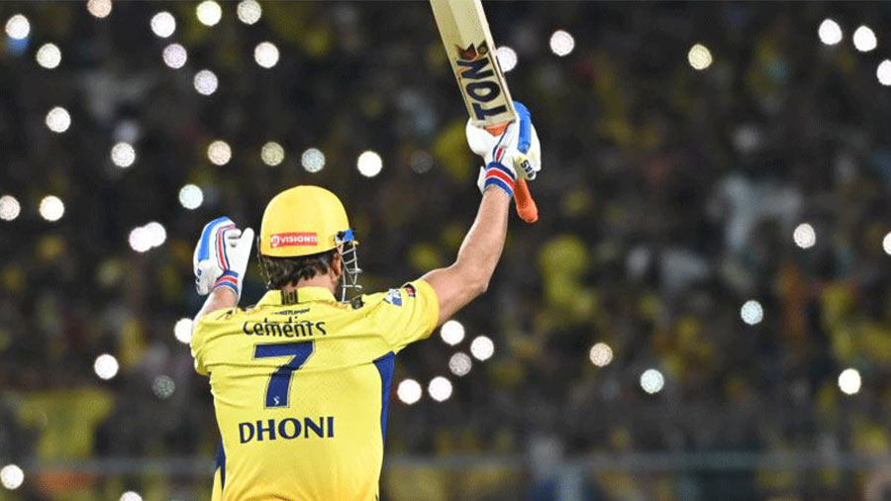
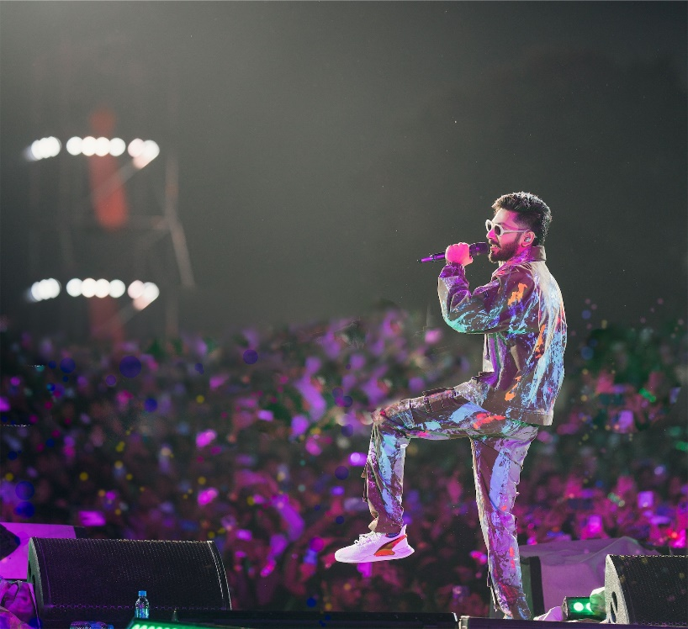
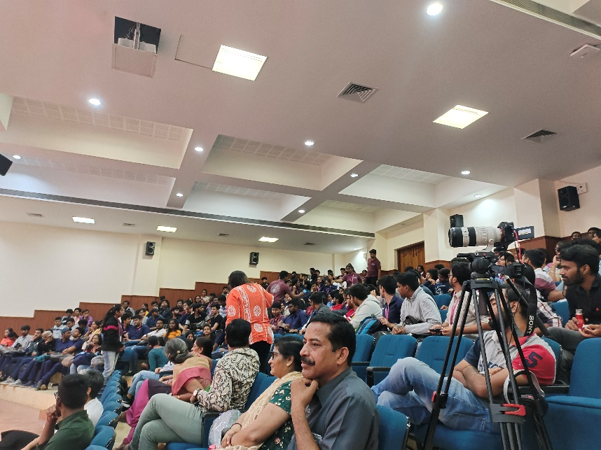
why this ? Motivation
SOCIAL PROBLEM

Slide 4
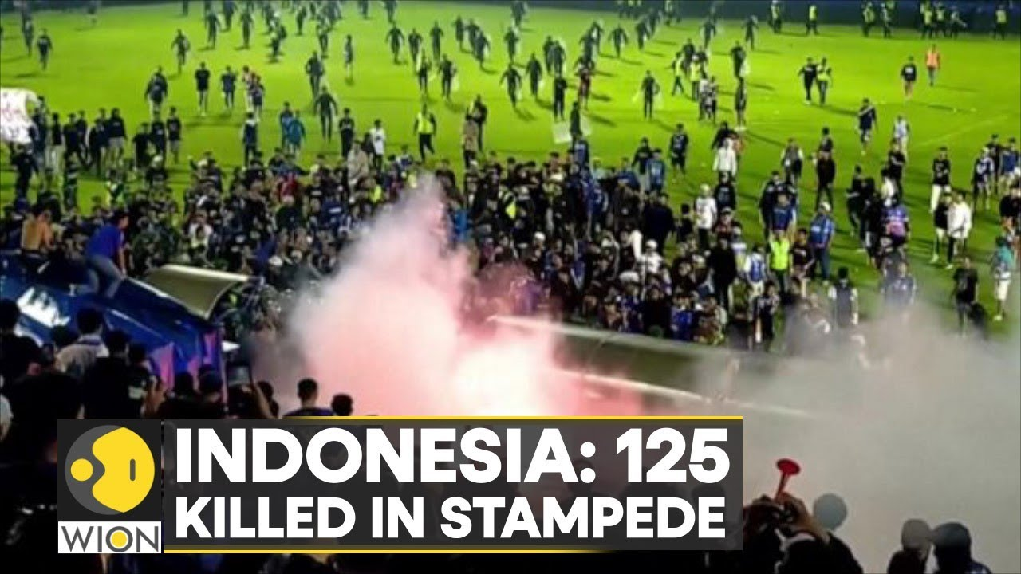
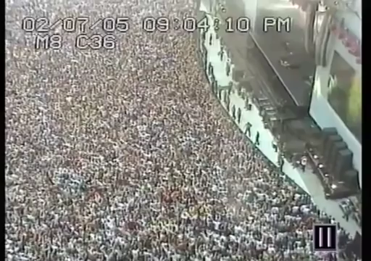
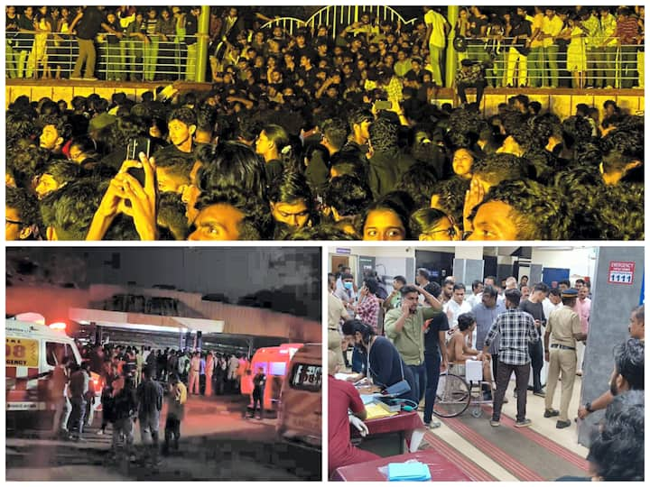
why this ? Motivation
- the
SOCIAL PROBLEM
Notes:
Indonesia Football Tragedy: 125 killed in stampede at Indonesia football match-Oct 3, 2022
4 students dead in Kochi university concert stampede, Chief Minister takes stock. Four students were killed and at least 64 were injured in a stampede at the Cochin University of Science and Technology (CUSAT) during a music concert on Saturday evening. Two of the injured are in a critical condition, officials said. –nov 23
In August 2023, at least 12 people were killed and 80 injured when a stampede occurred at the entrance to the Barea stadium in Madagascar for the opening ceremony of the Indian Ocean Island Games.

Slide 5
Problem Statement
Large-scale events such as music festivals, sports games, and public gatherings often face challenges in crowd management and safety.
Crowd management and safety at large events are critical concerns, especially when unexpected incidents or overcrowding can lead to accidents.

Slide 6
LITERATURE SURVEY
SL Number | Paper Title, Author, Year of Publication | Abstract , Technique mentioned | Limitations
1. | Still, K., Papalexi, M., Fan, Y., & Bamford, D. (2020). Place crowd safety, crowd science? Case studies and application. Journal of Place Management and Development, 13(4), 385-407. | Development and application of place crowd safety management tools Design, Information, Management-Ingress, Circulation, Egress (DIM-ICE) | Limitation of this paper is that it focuses only on detecting congestion but no other abnormalities.

Slide 7
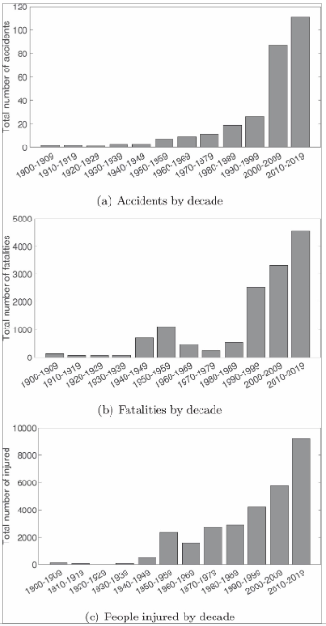
LITERATURE SURVEY

Slide 8
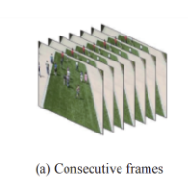
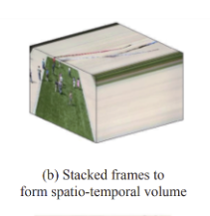
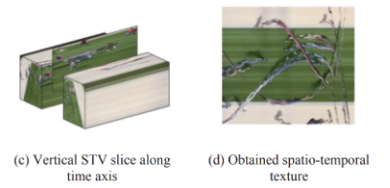
LITERATURE SURVEY
SL Number | Paper Title, Author, Year of Publication | Abstract , Technique mentioned | Limitations
2. | Hao, Y., Xu, Z. J., Liu, Y., Wang, J., & Fan, J. L. (2019). Effective crowd anomaly detection through spatio-temporal texture analysis. International Journal of Automation and Computing, 16(1), 27-39. | Spatio-temporal texture analysis approach using Gabor filtering, information entropy-based selection, and gray level co-occurrence matrix modeling to effectively detect abnormal crowd behaviors. | Occlusion handling Need for large annotated data Real-time optimizations.

Slide 9
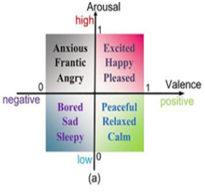
LITERATURE SURVEY
SL Number | Paper Title, Author, Year of Publication | Abstract , Technique mentioned | Limitations
3. | Zhang, X., Yang, X., Zhang, W., Li, G., & Yu, H. (2021). Crowd emotion evaluation based on fuzzy inference of arousal and valence. Neurocomputing, 445, 194-205. | Crowd behavior analysis Crowd emotion evaluation Fuzzy inference Emotional model Arousal and valence Crowd surveillance | Doesn't account for the meaning or context of the scene Making it less effective in distinguishing emotions in scenes with similar crowd movements but different meanings.

Slide 10
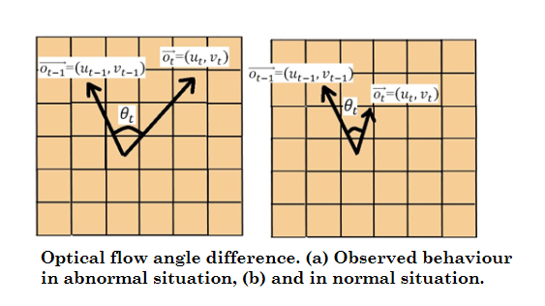
LITERATURE SURVEY
SL Number | Paper Title, Author, Year of Publication | Abstract , Technique mentioned | Limitations
4. | Direkoglu, C. (2020). Abnormal crowd behavior detection using motion information images and convolutional neural networks. IEEE Access, 8, 80408-80416. | Optical flow computation Motion information image (MII) generation Abnormal crowd behavior detection Convolutional neural networks | focuses only on detecting abnormal crowd behaviors like panic and escape, not other types of abnormalities

Slide 11
LITERATURE SURVEY
SL Number | Paper Title, Author, Year of Publication | Abstract , Technique mentioned | Limitations
5. | Packirisamy, T., & Klein, R. (2022, July). Dilated Convolution to Capture Scale Invariant Context in Crowd Density Estimation. In Proceedings of 43rd Conference of the South African Insti (Vol. 85, pp. 89-103). | utilizing dilated convolutions to capture scale-invariant context Techniques Mentioned: Baseline Approach Dilated Convolution Approach ASPP Approach | Dataset Specificity Sparse Crowd Images
Notes:
The effectiveness of the ASPP model in capturing scale-invariant context varies based on the dataset characteristics, with the ASPP model outperforming the dilated model in datasets like UCF CC 50 with larger scale variations but showing similar performance in datasets with less scale variation like ShanghaiTech Part A.

Slide 12
Objectives
Density of Crowd
Anomaly detection
Identify Fast Moving objects in the Crowd
Detect People in a Different Direction

Slide 13
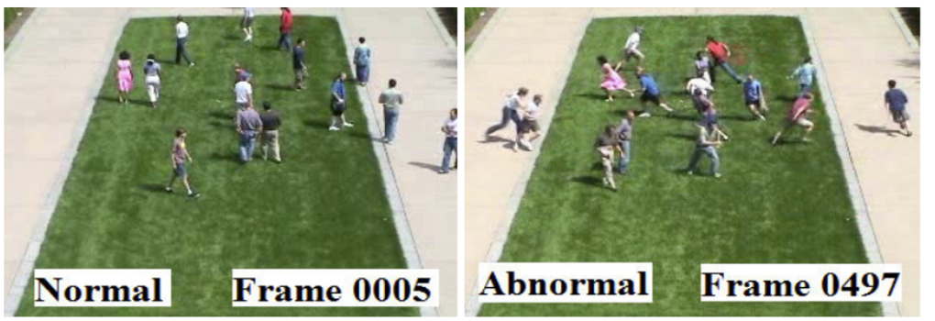
methodology
Dataset:
1.The UMN dataset:
The UMN dataset consist of 11 videos, and each video contains normal and abnormal crowd behaviors. There are three different scenes in this dataset (two outdoor scenes and one indoor scene).

Slide 14
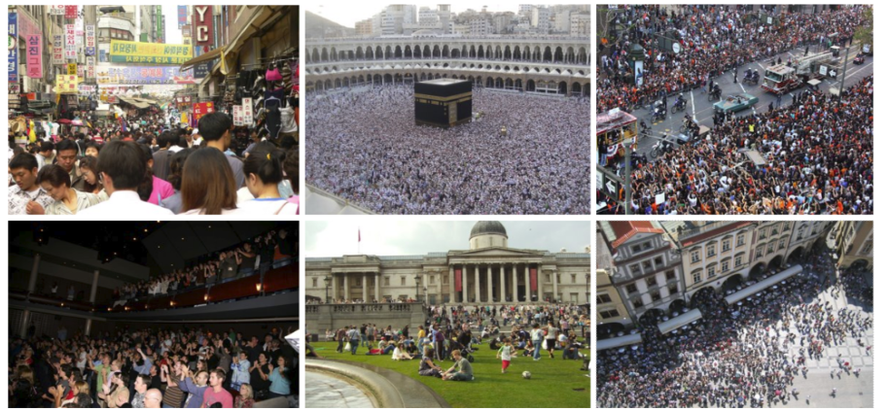
methodology
Dataset:
2.UCF-QNRF - A Large Crowd Counting Data Set
UCF-QNRF dataset contains 1535 images of crowd gather around the world in a variety of scenarios.

Slide 15
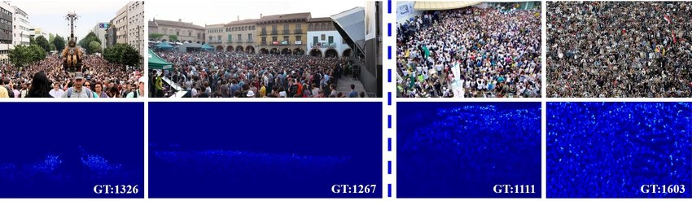
methodology
Dataset:
Shanghaitech dataset
The ShanghaiTech dataset is a large-scale crowd counting dataset that contains 1,198 annotated crowd images. The dataset is divided into two parts, Part-A and Part-B, with Part-A containing 482 images and Part-B containing 716 images.

Slide 16
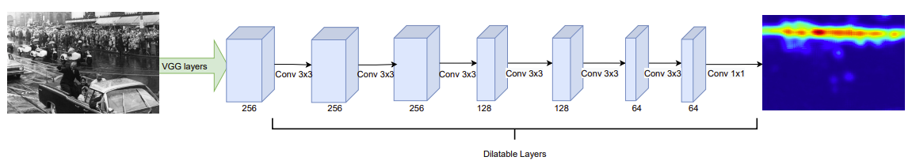


methodology
Objective 1: CNN with Dilation
Notes:
VGG Layers: VGG (Visual Geometry Group) is a deep convolutional neural network architecture that was proposed by Oxford's Visual Geometry Group in 20141. The VGG model gained popularity due to its simplicity and effectiveness in image classification tasks. The VGG layers mentioned in the study are the initial layers of a pre-trained VGG-16 network, which is utilized as the foundation for the crowd density estimation models.
Dilatable Layers: Dilatable layers refer to the layers in the crowd density estimation models that can have varying dilation rates. These layers are responsible for capturing contextual information at different scales by adjusting the dilation rate of the convolutional filters. Dilation is a technique that increases the receptive field of a filter without increasing the filter's size, allowing the model to consider more contextual information within the crowd scenes.

Slide 17
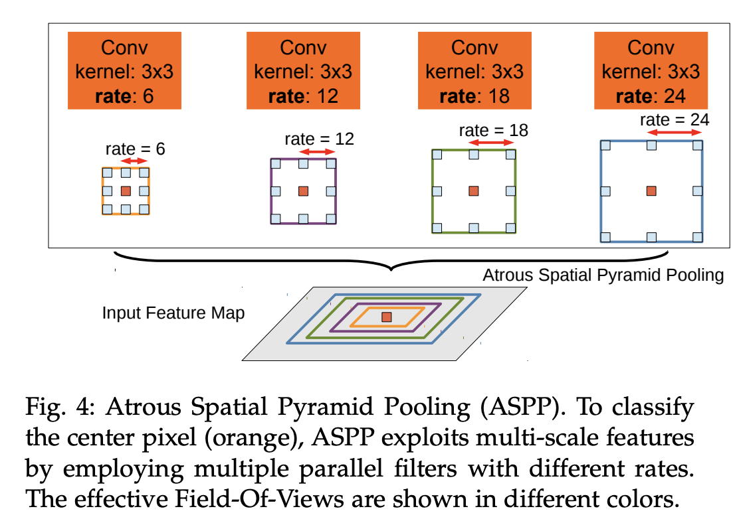
methodology
Objective 1: CNN with Dilation and ASPP
Notes:
ASPP (Atrous Spatial Pyramid Pooling): ASPP is a technique that involves filtering an input using a variety of dilated kernels with different dilation rates, along with a 1x1 convolution and global average pooling. The outputs of these operations are then concatenated, and a 1x1 convolution is applied to reduce the depth of the feature maps. ASPP allows for the capture of contextual information at various scales, enabling the model to consider contextual information around objects that may be obscured or at a low resolution. This is particularly useful in crowd density estimation, where scale variations and occlusion are common challenges.

Slide 18
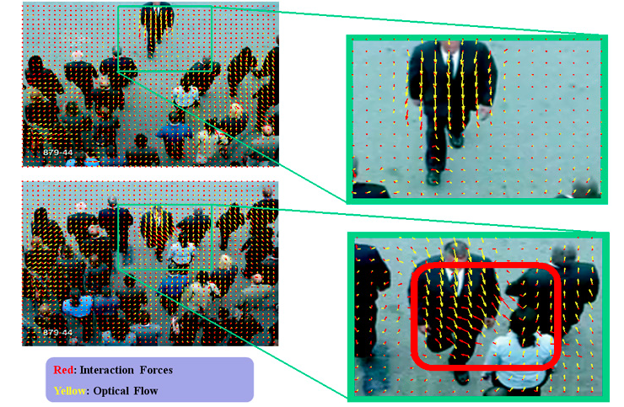
methodology
Objective 2: Optical Flow

Slide 19
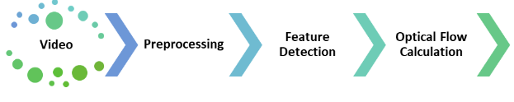
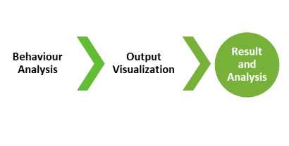
methodology
Objective 2: Optical Flow

Slide 20
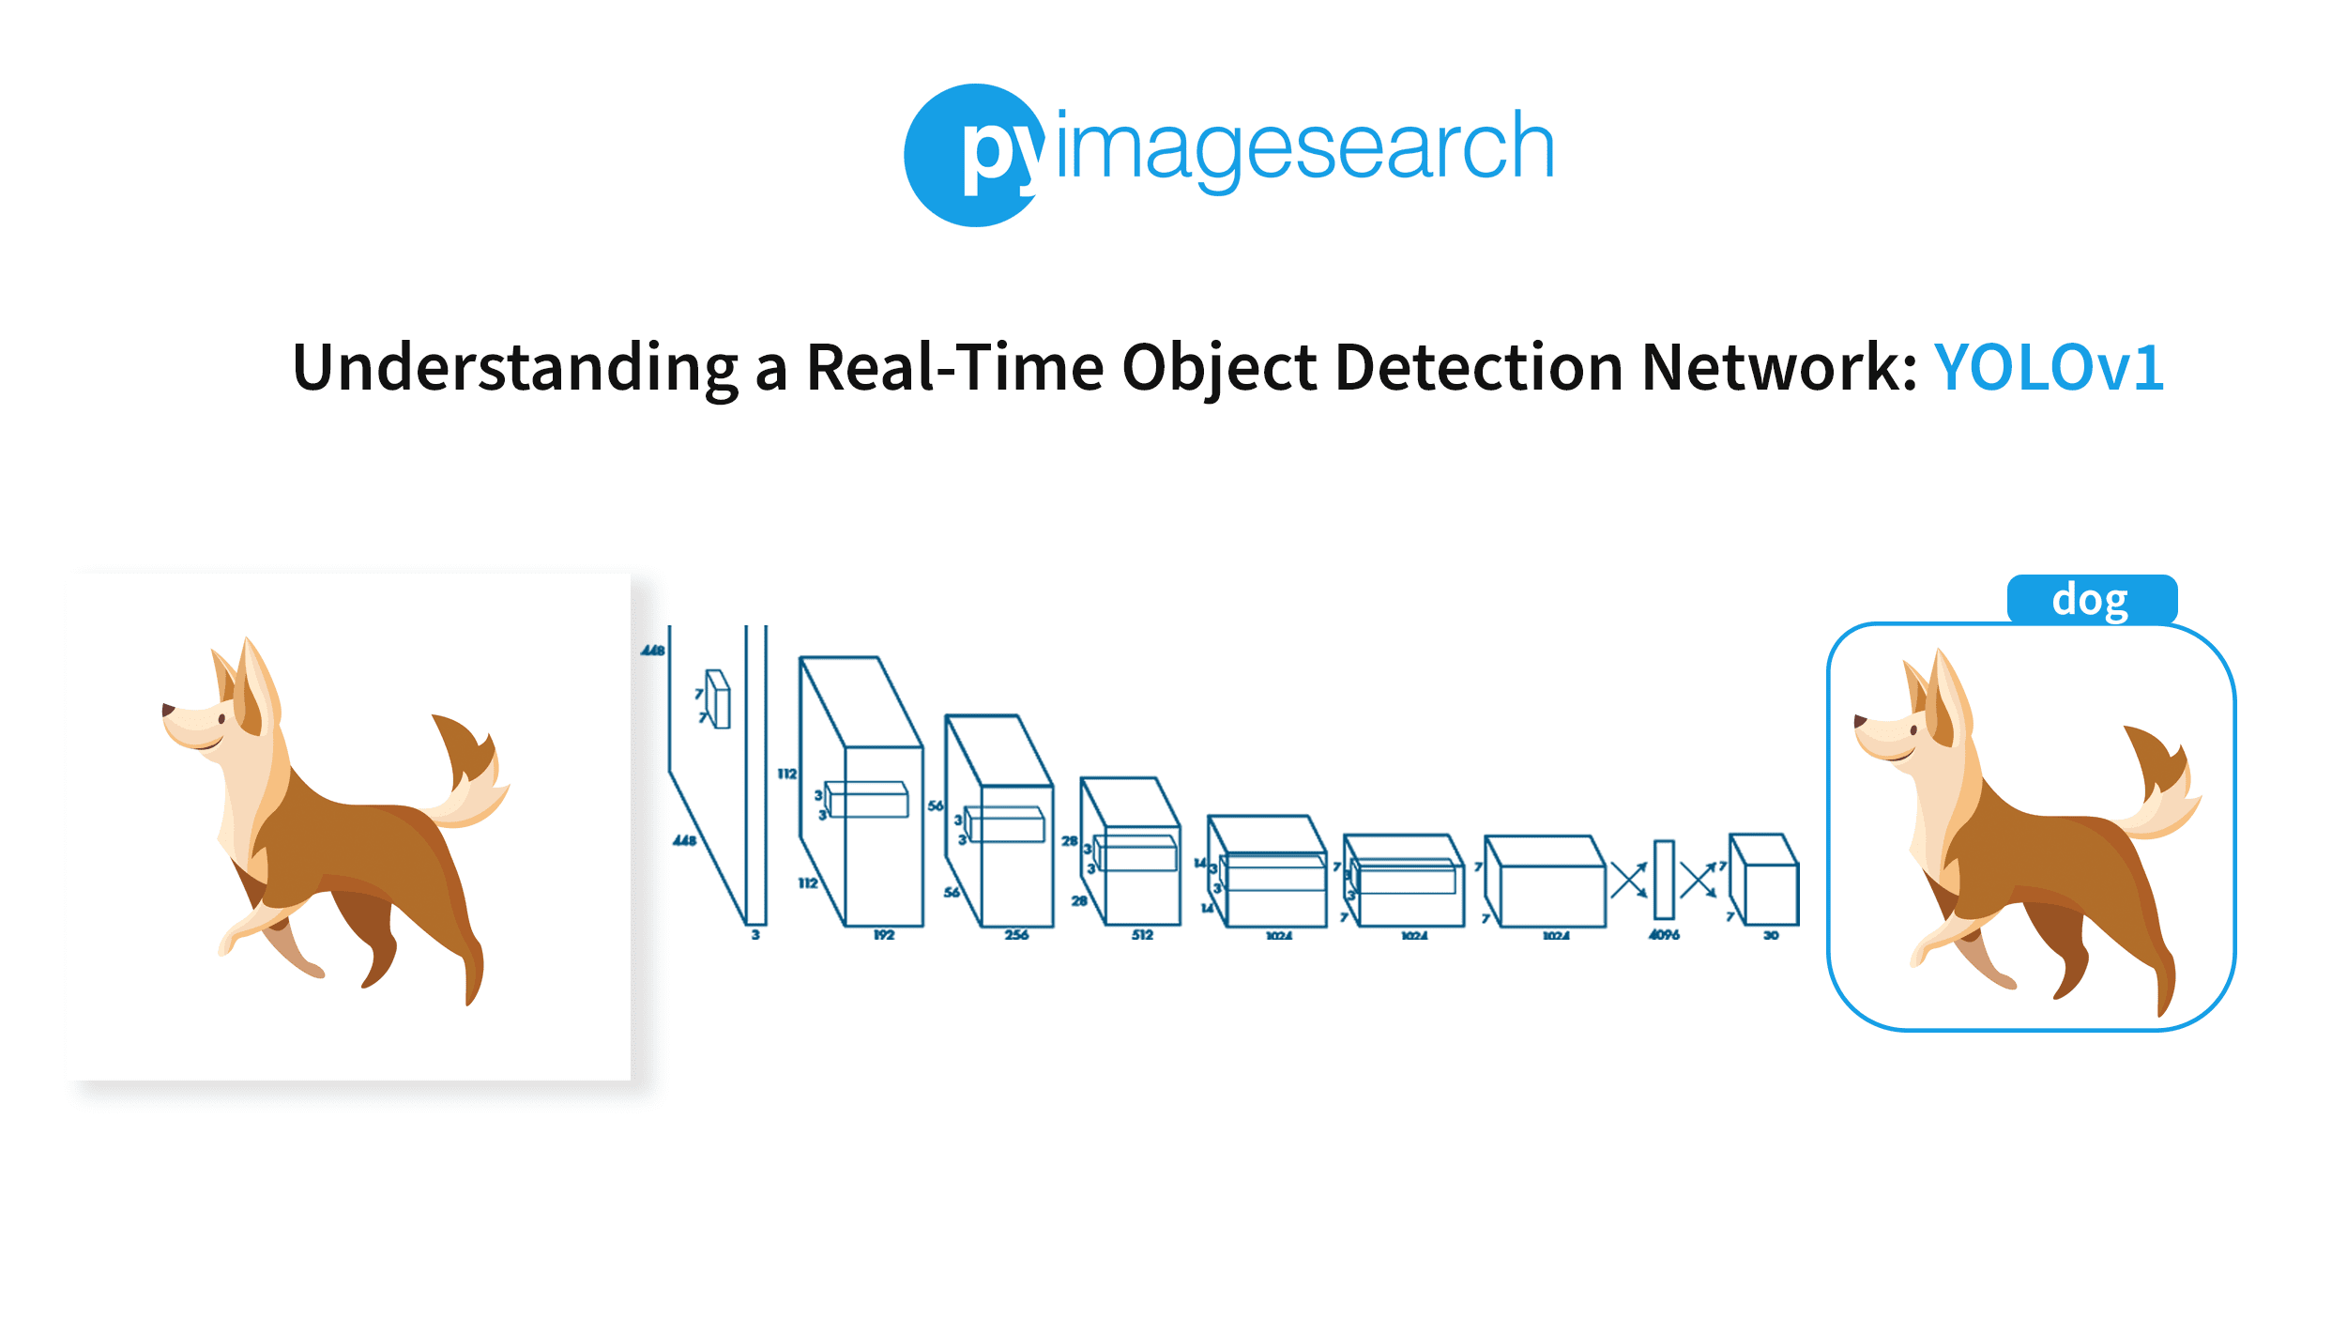
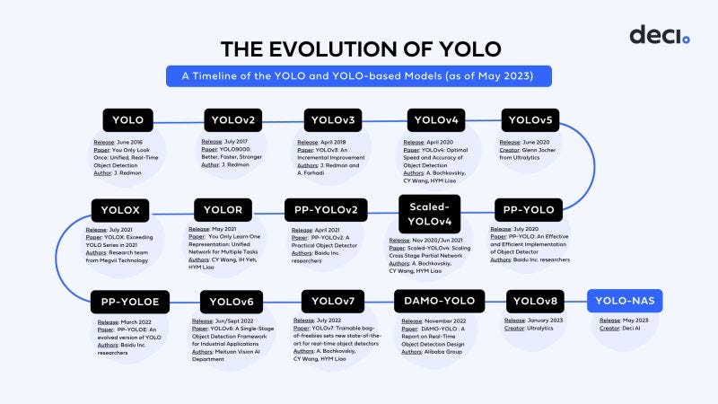
methodology
Objective 3: YOLO tracking
Notes:
YOLO processes the entire image in one pass, making it faster than traditional methods that involve multiple passes over the image.

Slide 21
Implementation

Slide 22
Summary

Slide 23
References [ieee format]
[1] Still, K., Papalexi, M., Fan, Y., & Bamford, D. (2020). Place crowd safety, crowd science? Case studies and application. Journal of Place Management and Development, 13(4), 385-407.
[2] Hao, Y., Xu, Z. J., Liu, Y., Wang, J., & Fan, J. L. (2019). Effective crowd anomaly detection through spatio-temporal texture analysis. International Journal of Automation and Computing, 16(1), 27-39.
[3] Direkoglu, C. (2020). Abnormal crowd behavior detection using motion information images and convolutional neural networks. IEEE Access, 8, 80408-80416.
[4]Zhang, X., Yang, X., Zhang, W., Li, G., & Yu, H. (2021). Crowd emotion evaluation based on fuzzy inference of arousal and valence. Neurocomputing, 445, 194-205.

Slide 24
Thank You
Any questions?

